Slide 1
Student Nutrition Android App
Final Presentation
12 December 2016
CSCI 413, Fall Semester 2016
P. Abts, G. Askegard, D. Beckmann, B. Chastain, J. Falcon, C. Fradenburgh, Z. Grosz,
T. Johnson, V. Kyereme, G. Moe, S. Monick, R. Nelson, M. Olson, J. Pollman, J. Raboin

Slide 2
Presentation Outline
Project Overview
Process
Documentation
Live Demonstration
Lessons Learned
What’s Next

Slide 3
Project Overview
Android Mobile App
Record Meals
View Nutrient Levels
Get Recommendations
MySQL Server
Store Venues
Store Menu Items
Store Recommendations
Overview ------------- Process ------------- Documentation ------------- Live Demo ------------- Lessons Learned------------- What’s Next?

Slide 4
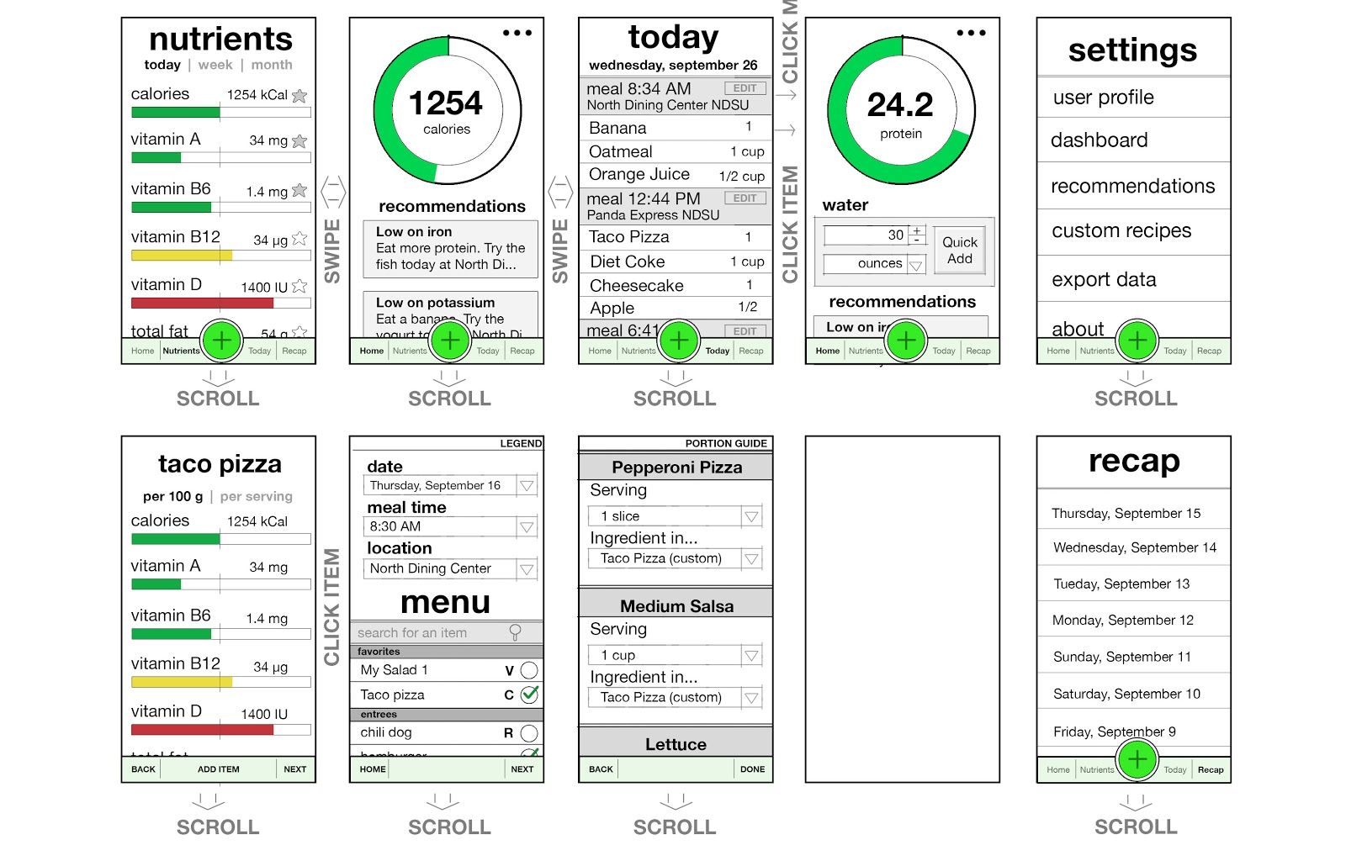
Process We Went Through
GUI Mockup
Development Models
Agile: MySQL Server, App GUI
Waterfall: App Engine
Sprints
2 Weeks per sprint (6 sprints total)
Small Groups of 2 – 4 people
Scrum meeting every week
Tools
Slack
Google Drive
GITHub
Android Studio
Overview ------------- Process ------------- Documentation ------------- Live Demo ------------- Lessons Learned------------- What’s Next?

Slide 5
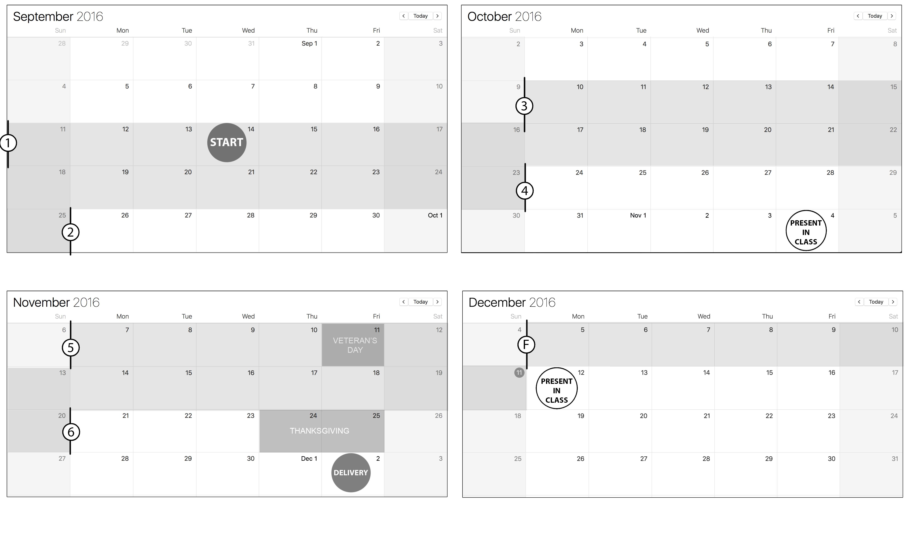
Process Schedule
6 Sprints
Overview ------------- Process ------------- Documentation ------------- Live Demo ------------- Lessons Learned------------- What’s Next?

Slide 6
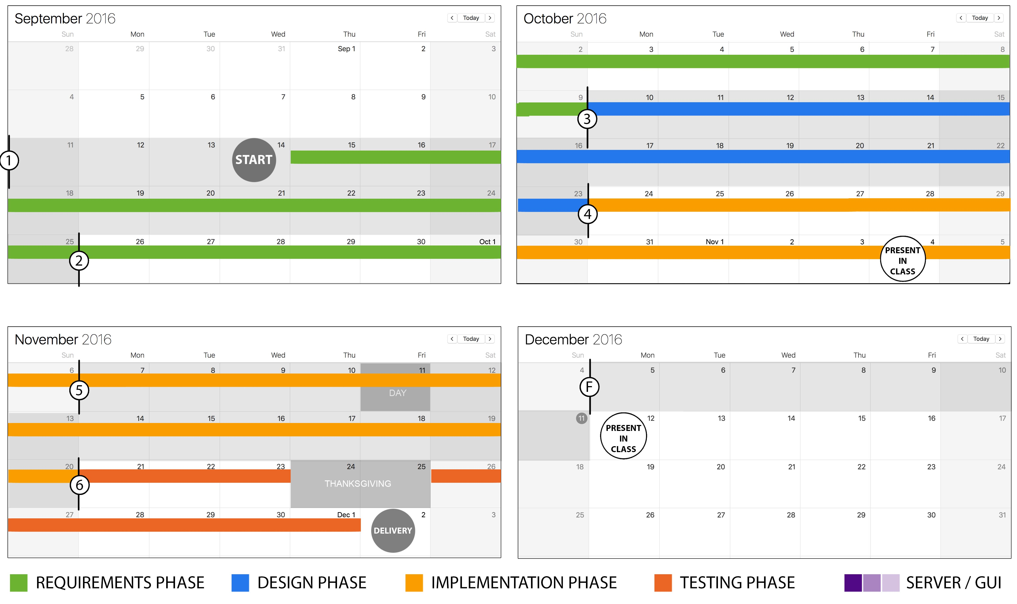
Process Schedule
6 Sprints
App Engine Plan
Overview ------------- Process ------------- Documentation ------------- Live Demo ------------- Lessons Learned------------- What’s Next?

Slide 7
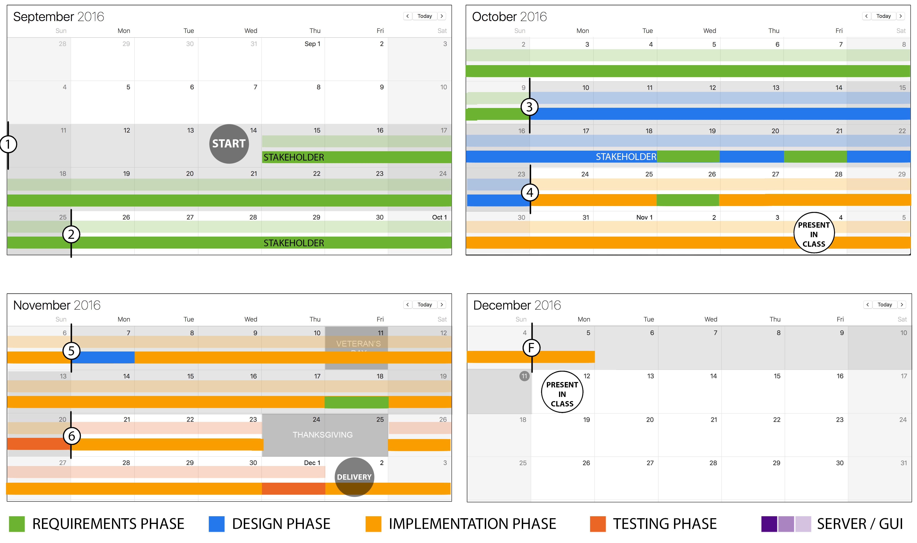
Process Schedule
6 Sprints
App Engine Plan
App Engine Actual
Overview ------------- Process ------------- Documentation ------------- Live Demo ------------- Lessons Learned------------- What’s Next?

Slide 8
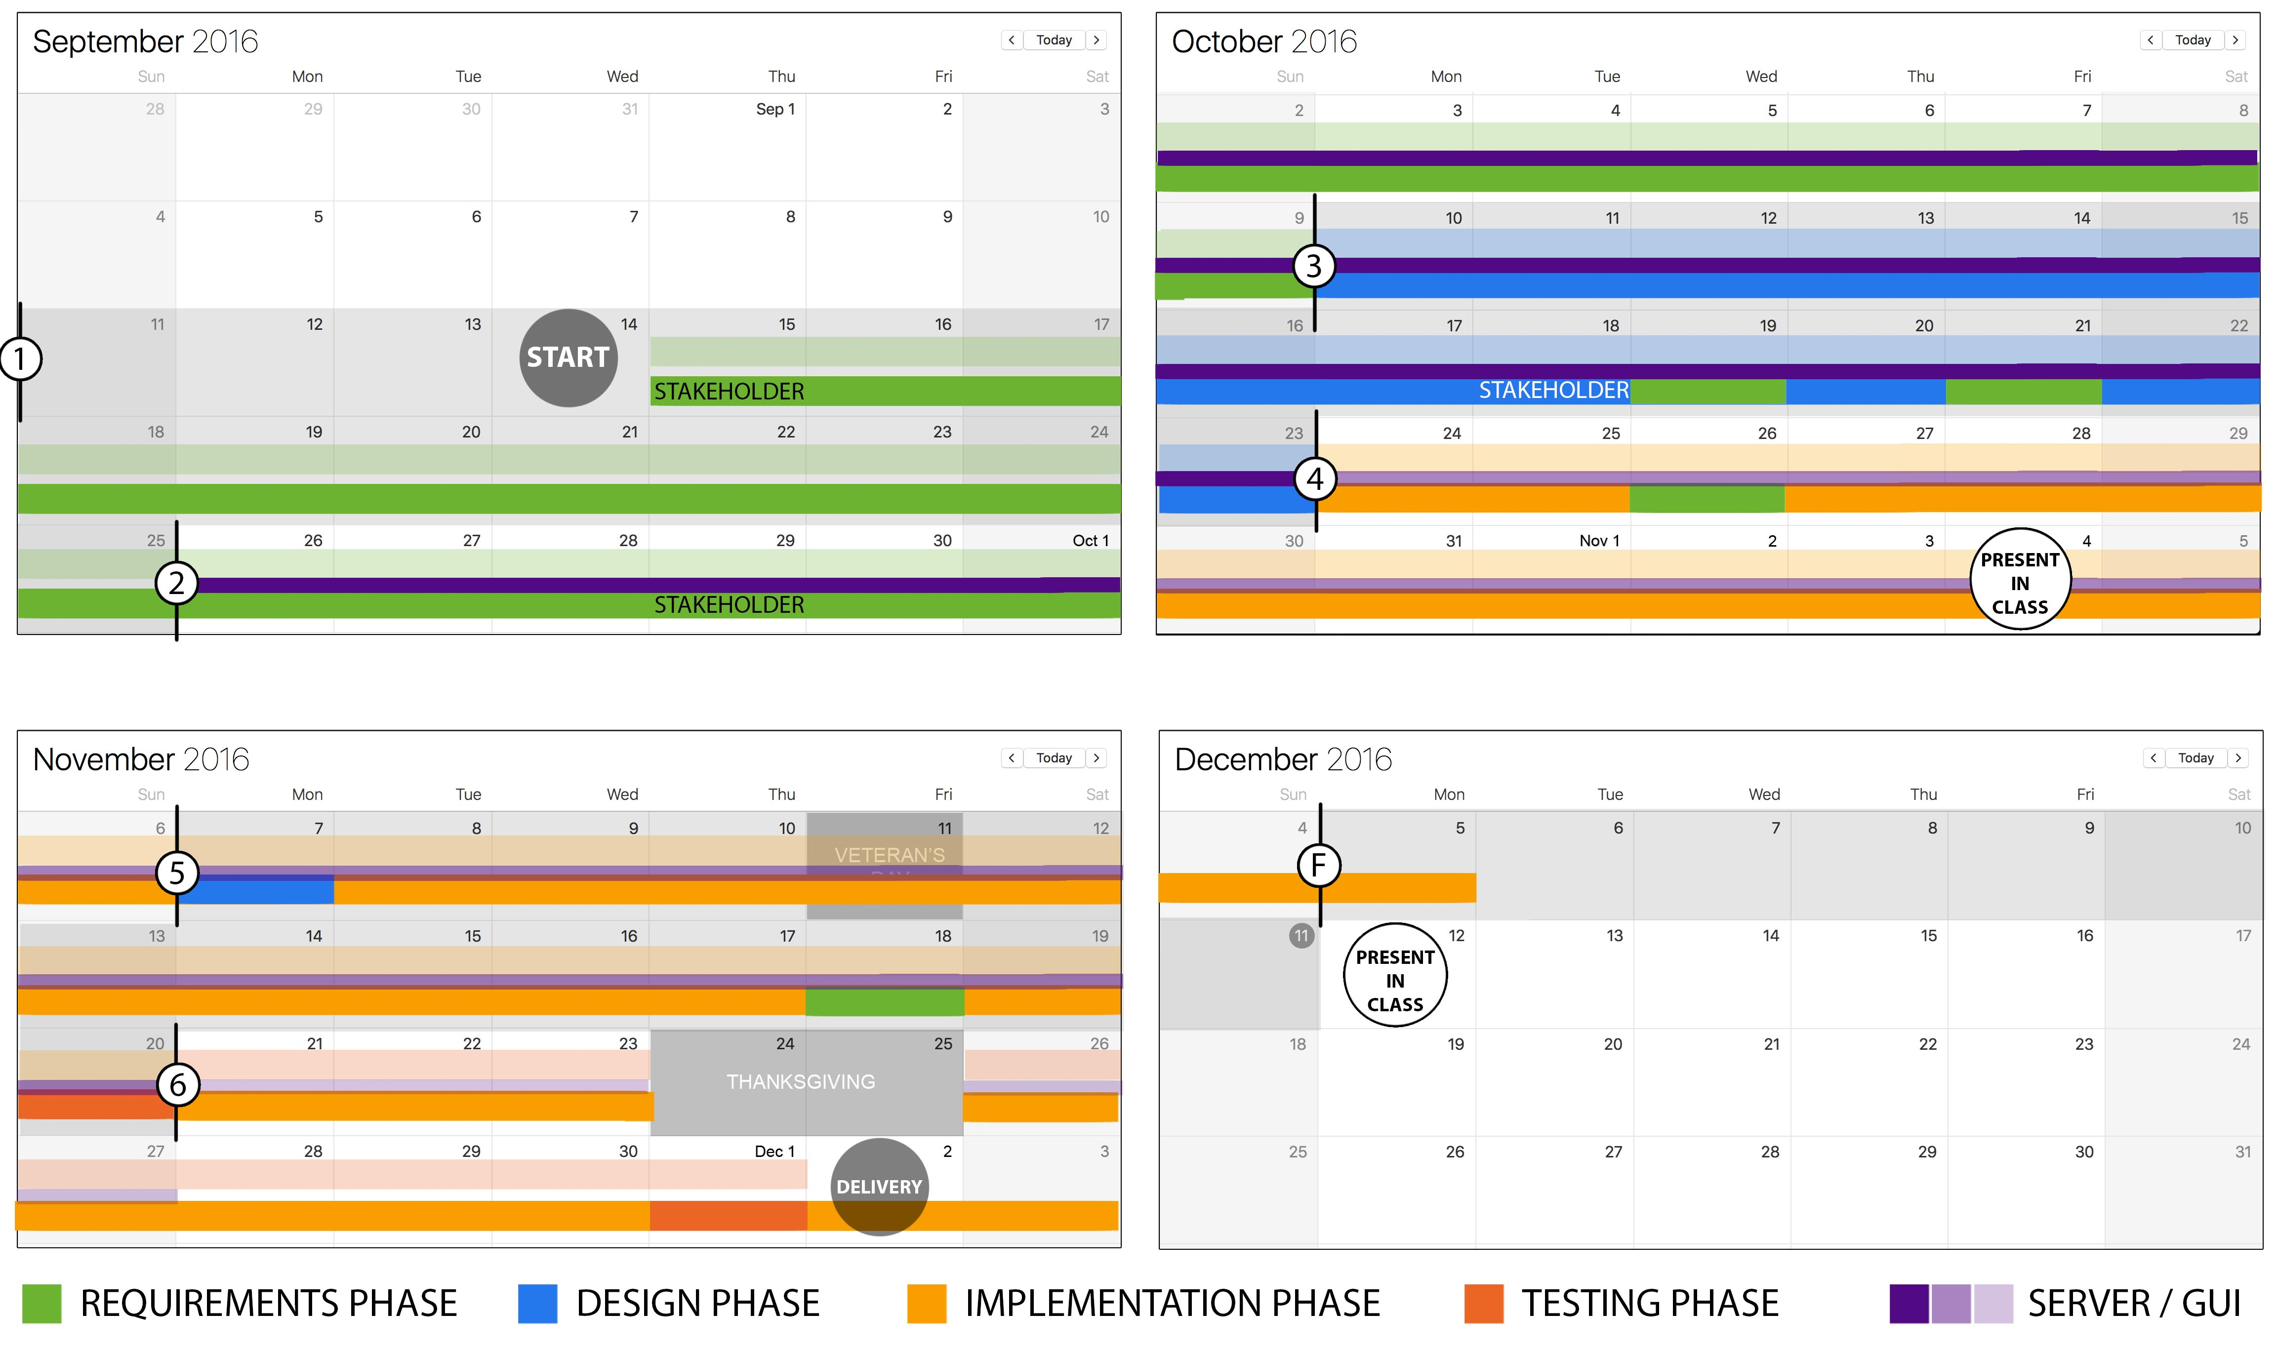
Process Schedule
6 Sprints
App Engine Plan
App Engine Actual
Server / GUI
Overview ------------- Process ------------- Documentation ------------- Live Demo ------------- Lessons Learned------------- What’s Next?

Slide 9
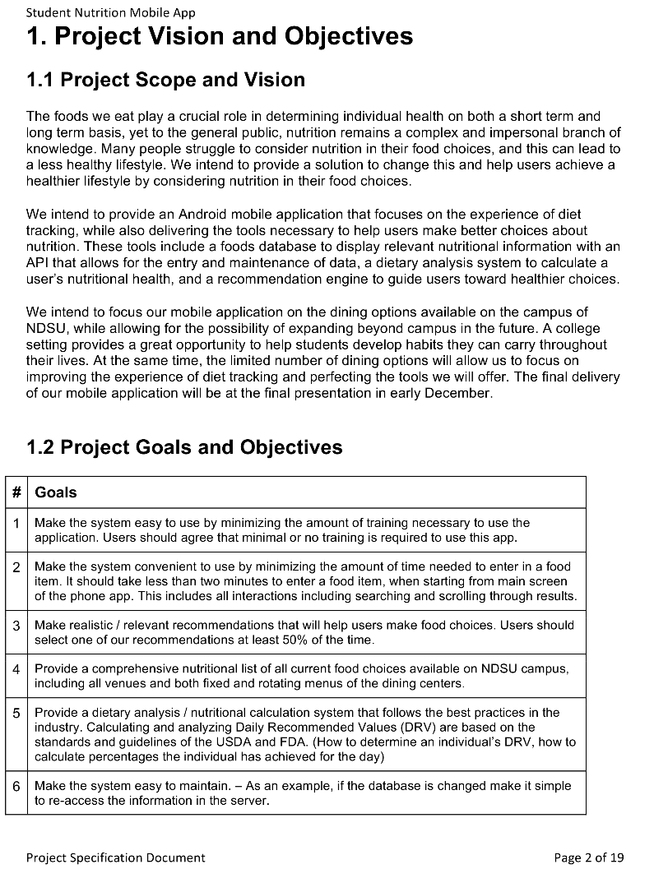
Documentation
Deliverable Documents
Specification Doc ←
Requirements Doc
System Design Doc & UML Diagram
Program Design Doc & UML Diagram
Testing Doc
Server Doc / API
Additional
Notes from meetings with stakeholders
Overview ------------- Process ------------- Documentation ------------- Live Demo ------------- Lessons Learned------------- What’s Next?

Slide 10
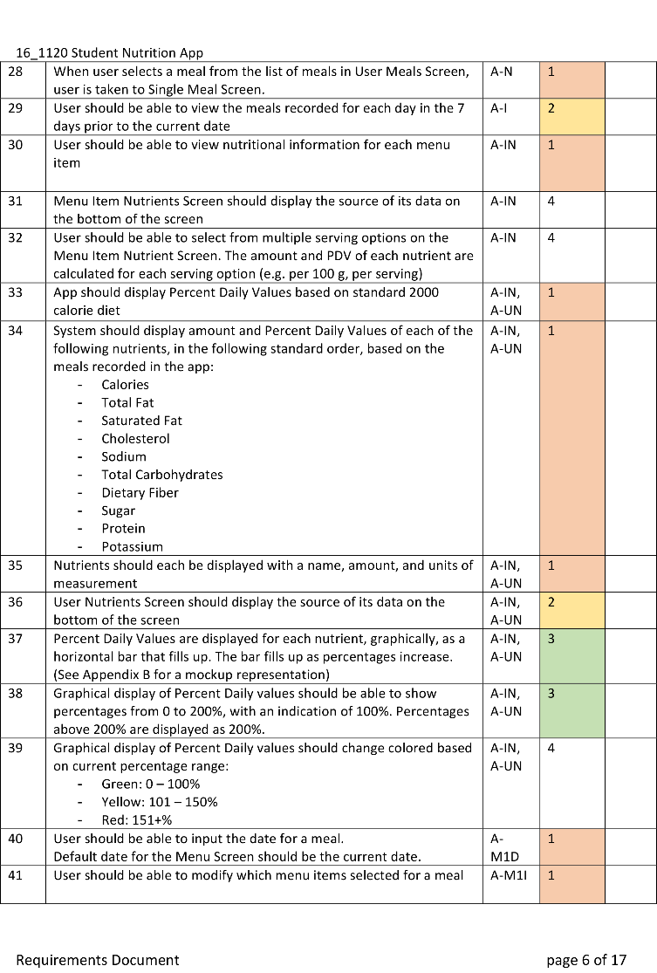
Documentation
Deliverable Documents
Specification Doc
Requirements Doc ←
System Design Doc & UML Diagram
Program Design Doc & UML Diagram
Testing Doc
Server Doc / API
Additional
Notes from meetings with stakeholders
Overview ------------- Process ------------- Documentation ------------- Live Demo ------------- Lessons Learned------------- What’s Next?

Slide 11
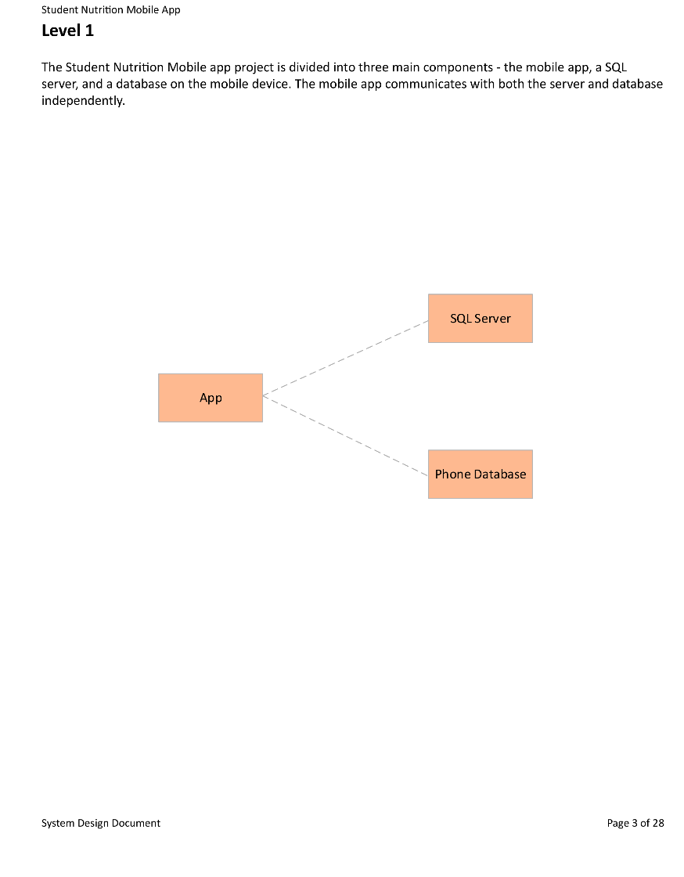
Documentation
Deliverable Documents
Specification Doc
Requirements Doc
System Design Doc & UML Diagram ←
Program Design Doc & UML Diagram
Testing Doc
Server Doc / API
Additional
Notes from meetings with stakeholders
Overview ------------- Process ------------- Documentation ------------- Live Demo ------------- Lessons Learned------------- What’s Next?

Slide 12
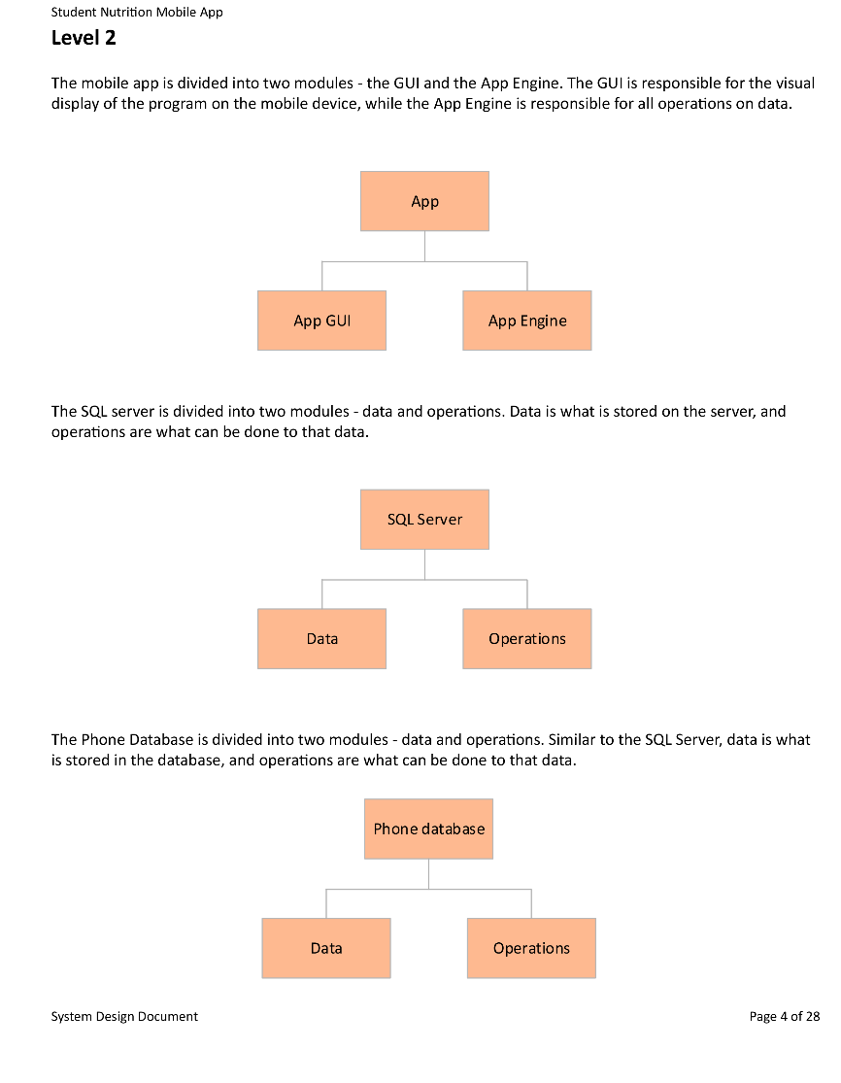
Documentation
Deliverable Documents
Specification Doc
Requirements Doc
System Design Doc & UML Diagram ←←
Program Design Doc & UML Diagram
Testing Doc
Server Doc / API
Additional
Notes from meetings with stakeholders
Overview ------------- Process ------------- Documentation ------------- Live Demo ------------- Lessons Learned------------- What’s Next?

Slide 13
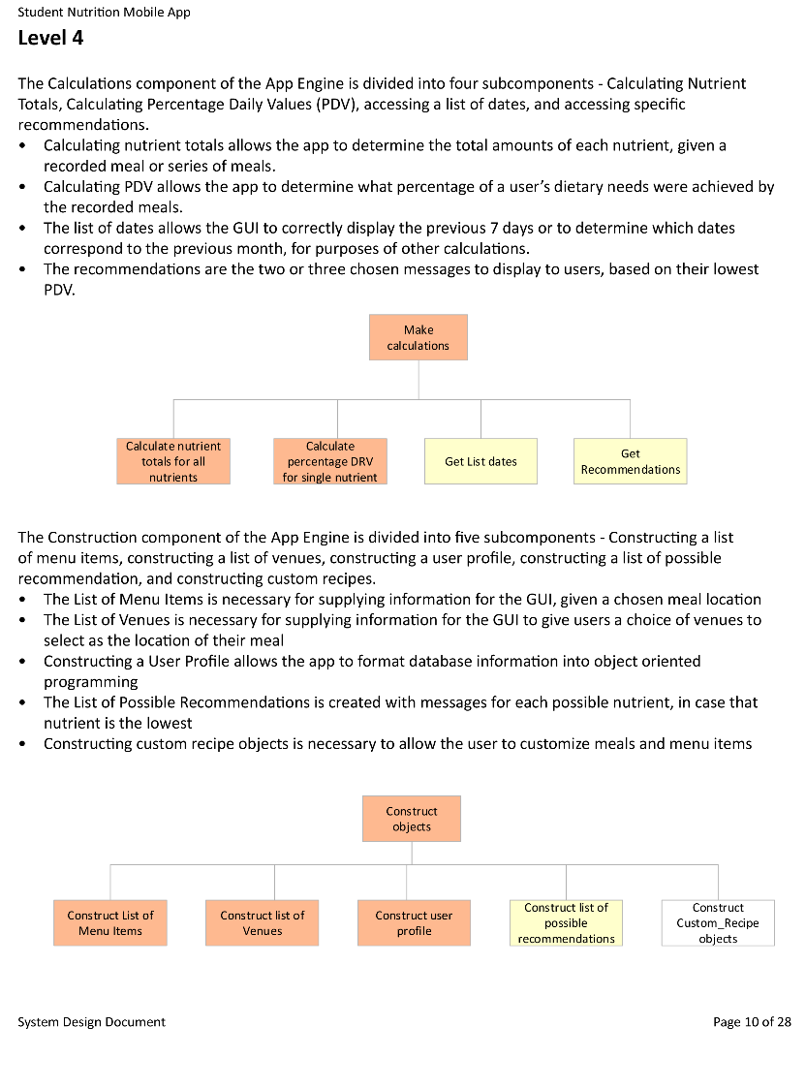
Documentation
Deliverable Documents
Specification Doc
Requirements Doc
System Design Doc & UML Diagram ←←←
Program Design Doc & UML Diagram
Testing Doc
Server Doc / API
Additional
Notes from meetings with stakeholders
Overview ------------- Process ------------- Documentation ------------- Live Demo ------------- Lessons Learned------------- What’s Next?

Slide 14
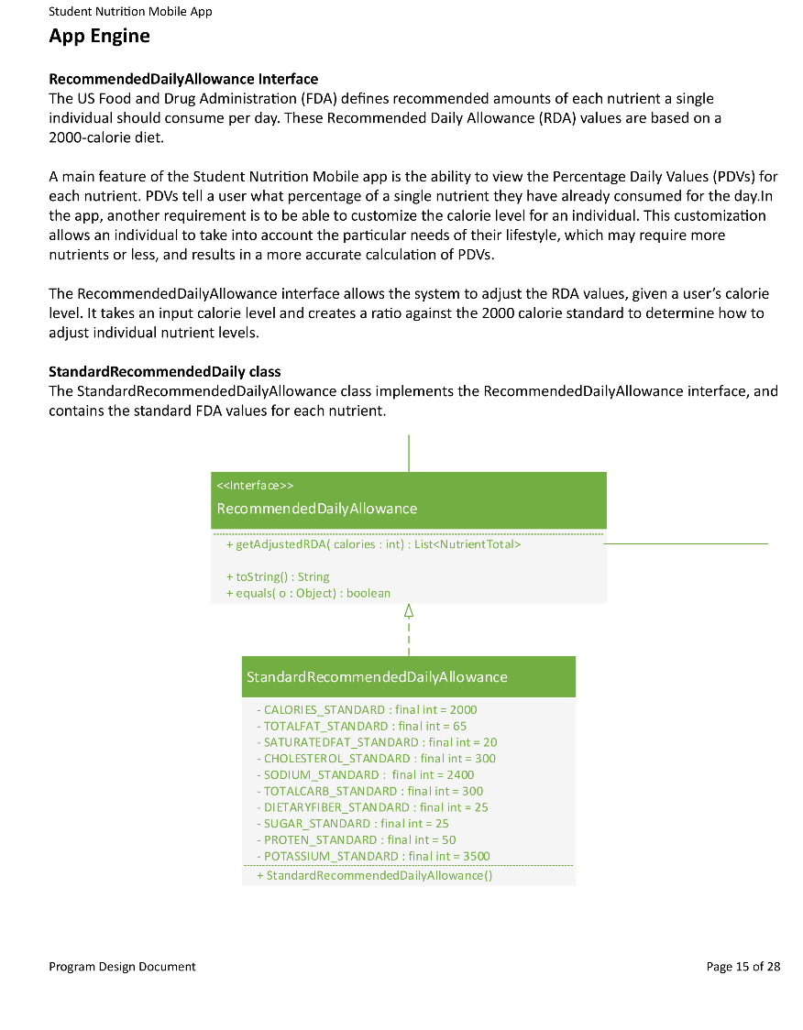
Documentation
Deliverable Documents
Specification Doc
Requirements Doc
System Design Doc & UML Diagram
Program Design Doc & UML Diagram ←
Testing Doc
Server Doc / API
Additional
Notes from meetings with stakeholders
Overview ------------- Process ------------- Documentation ------------- Live Demo ------------- Lessons Learned------------- What’s Next?

Slide 15
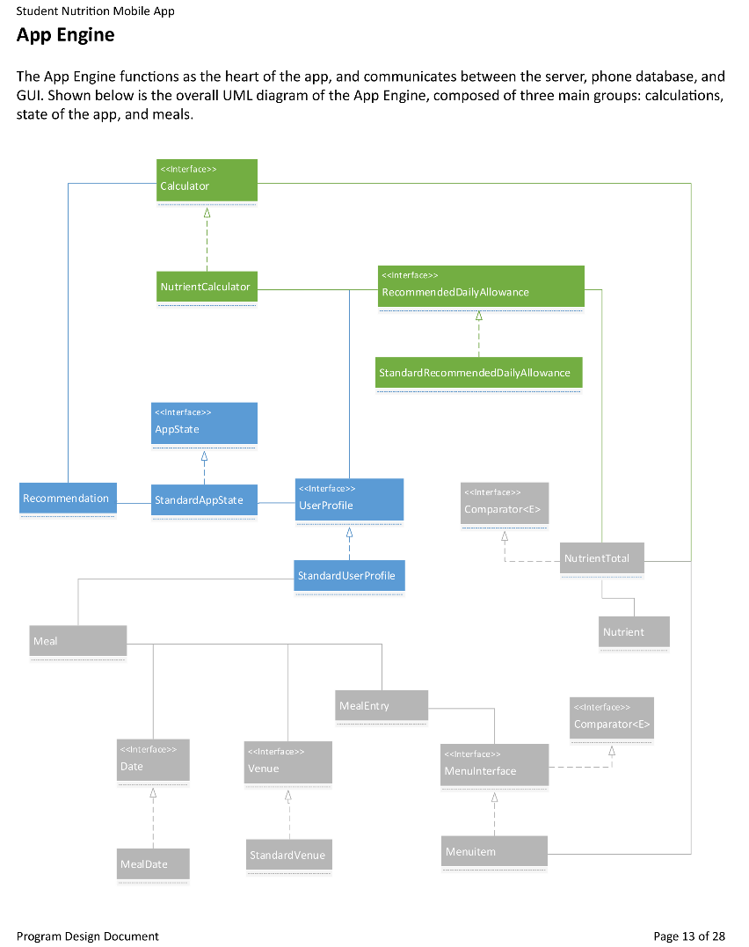
Documentation
Deliverable Documents
Specification Doc
Requirements Doc
System Design Doc & UML Diagram
Program Design Doc & UML Diagram ←←
Testing Doc
Server Doc / API
Additional
Notes from meetings with stakeholders
Overview ------------- Process ------------- Documentation ------------- Live Demo ------------- Lessons Learned------------- What’s Next?

Slide 16
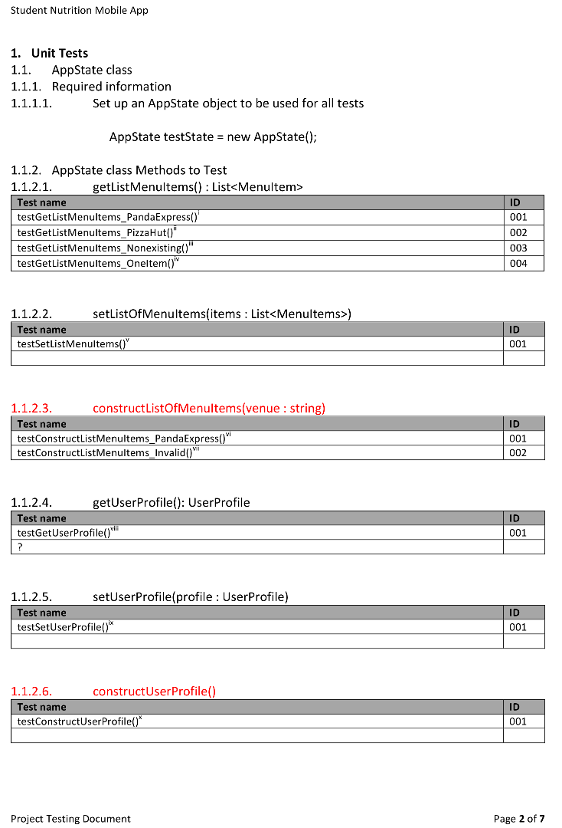
Documentation
Deliverable Documents
Specification Doc
Requirements Doc
System Design Doc & UML Diagram
Program Design Doc & UML Diagram
Testing Doc ←
Server Doc / API
Additional
Notes from meetings with stakeholders
Overview ------------- Process ------------- Documentation ------------- Live Demo ------------- Lessons Learned------------- What’s Next?

Slide 17
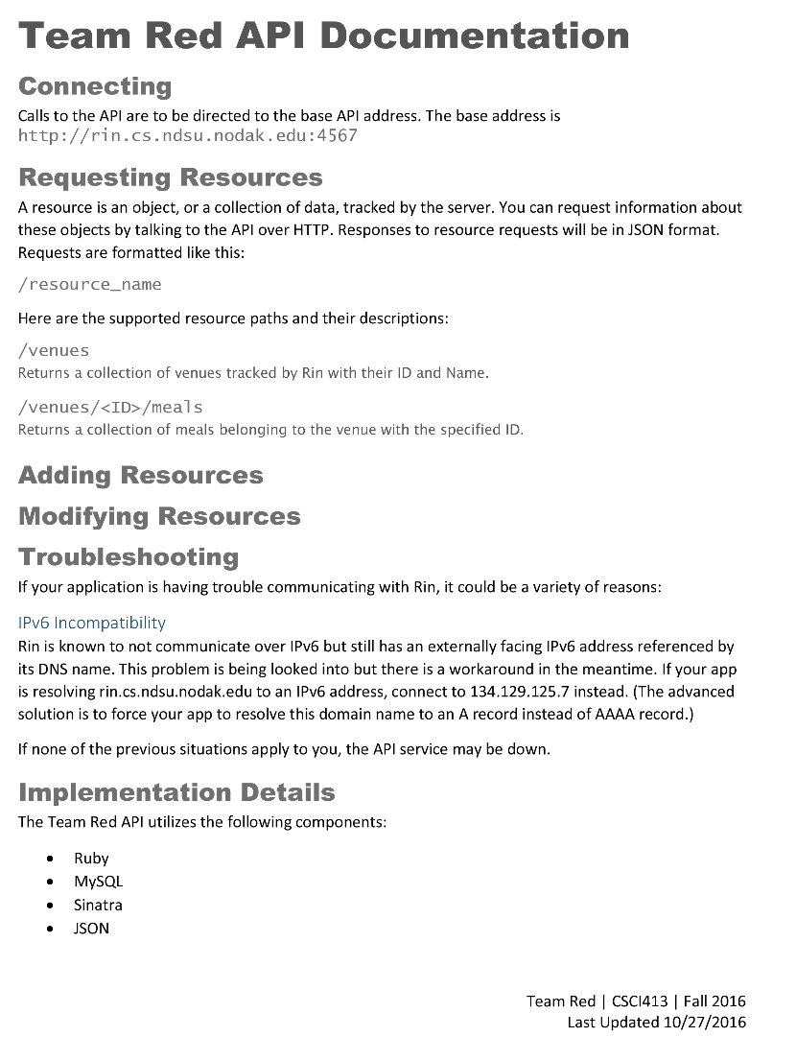
Documentation
Deliverable Documents
Specification Doc
Requirements Doc
System Design Doc & UML Diagram
Program Design Doc & UML Diagram
Testing Doc
Server Doc / API ←
Additional
Notes from meetings with stakeholders
Overview ------------- Process ------------- Documentation ------------- Live Demo ------------- Lessons Learned------------- What’s Next?

Slide 18
Live Demonstration
Server
Add new data http://students.cs.ndsu.nodak.edu/~johns327/rinform/
App
Access actual list of venues from server
Access all app screens
Record a Meal
View Nutrient Levels
Get Recommendations
Overview ------------- Process ------------- Documentation ------------- Live Demo ------------- Lessons Learned------------- What’s Next?

Slide 19
Lessons Learned
Complete Prototyping from the beginning
Problems late in the game
Develop Engine, GUI, MySQL Server together, incrementally
Get it to work first for a single feature, before expanding
Prioritize keeping everyone on the same page
Update entire team about all revisions and new work
Peer Reviews
Accountability – did you get your task done?
Quality – is your deliverable good enough for the next person to use?
Feedback – need to make necessary changes to leadership style, individual effort?
Overview ------------- Process ------------- Documentation ------------- Live Demo ------------- Lessons Learned------------- What’s Next?

Slide 20
What’s Next?
Interface for Uploading Information to the server
Dr. Stastny, Health, Nutrition, and Exercise Sciences Department, NDSU
Ability to upload data for her course and the “800 Café” student restaurant project
Restaurant Operations Desktop Module
Dr. Asperin, Hospitality and Tourism Management Department, NDSU
Calculating cost of ingredients, cost of meal
Implement remaining Critical and High-Priority requirements
Additional venues near campus and on campus
Create ‘permanent’ HTML page for adding information to the Server
Implement Low-Priority and Nice-To-Have requirements
Add custom meals
Export data in a readable, printable format
Login screen and ability to save user profile data on the server
Overview ------------- Process ------------- Documentation ------------- Live Demo ------------- Lessons Learned------------- What’s Next?

Slide 21
Thank you!

